Slide 1


R.B.D
BORROW DONATE
RENT
D O Y O U H A V E A L O T O F S T U F F A N D D O N O T K N O W W H A T T O D O
WIII T H III T ?

Slide 2



lots of stuff! what can i
items i purchased and did no use.
i have items that i rarely use
do?
i have items i would like to donate

Slide 3


Facts on the market
According to Statista, the global sharing economy market was valued at approximately $120 billion in 2019. The report projected that the market would reach around $335 billion by 2025, indicating a substantial growth trajectory.
Millennials and Gen Z are major contributors to the growth of the rental market, as they value access over ownership and seek cost- effective and sustainable options.
The rise of the sharing economy has fueled the growth of the rental market, with consumers increasingly opting to rent items instead of purchasing them outright.

Slide 4
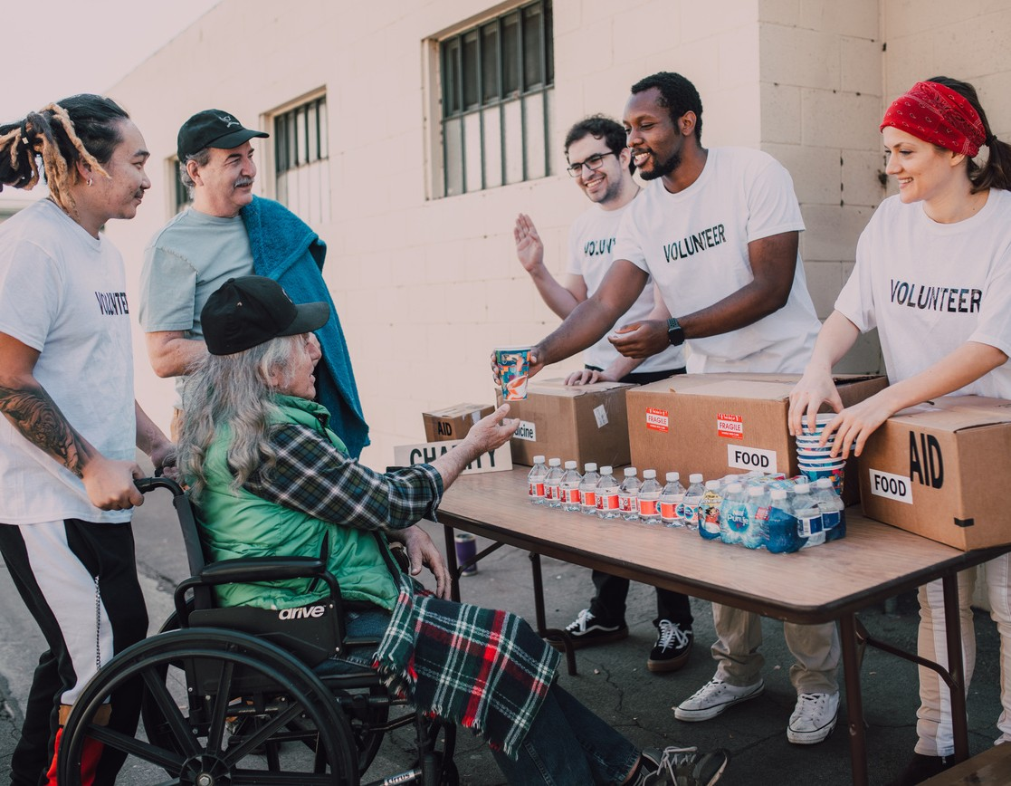
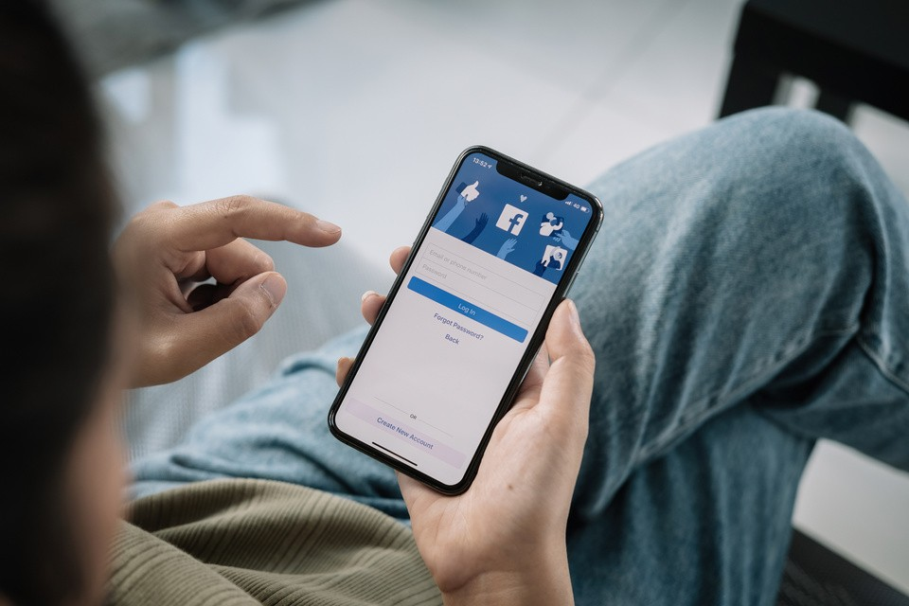
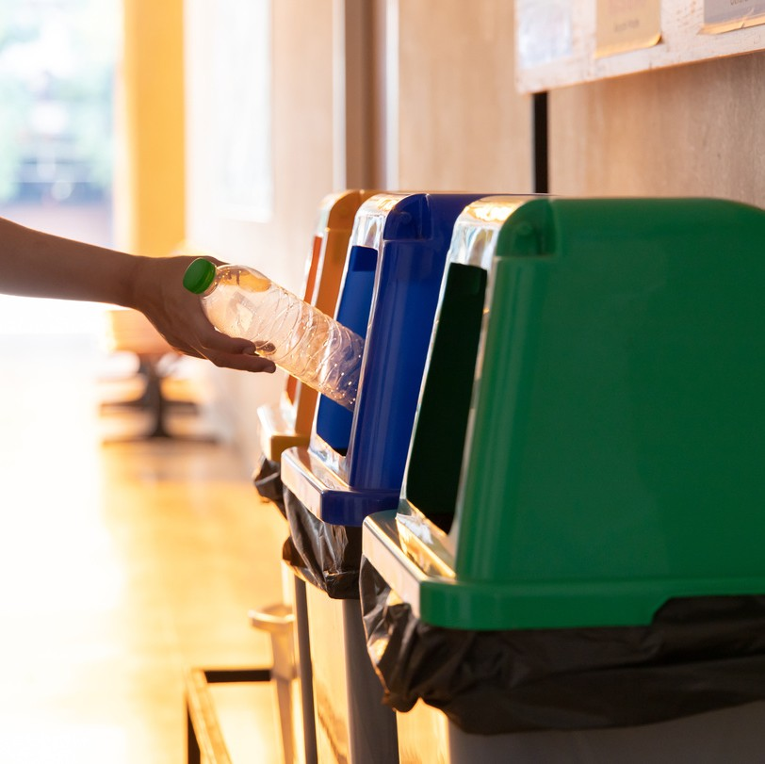


DONATING
the old fationed way , searching for a association gather the stuff.
Possible
Solutions
SOCIAL MEDIA GROUBS
sharing stuff accross social
,media platforms.
GARBAGE
the most simple and the last solution
SELLING
some people prefer to benefit from the stuff they own

Slide 5





Our Solution
Eco friendly
ADDITIONAL INCOME
guaranteed

Slide 6
Our Competitors
easy to
use
fast service
steady
income
reachable
audience
R.B.D
Amazon Yad 2
social midea groups
Ebay

Slide 7

INCOME GENERATION
Users can earn income by renting out their unused or underutilized possessions through the app.
Market Opportunity
MARKET SIZE AND OPPORTUNITY
The sharing economy market is projected to reach
$335 billion dollars by 2025 year.
TARGETING DIVERSE USER SEGMENTS:
our app has the potential to cater to diverse user segments, such as students, travelers, and homeowners.

Slide 8


Business Model
design
we aim is to provide an easy user inteface
financial
a new income mithod for the audience
collaborations
partnerships with local businesses, delivery services

Slide 9
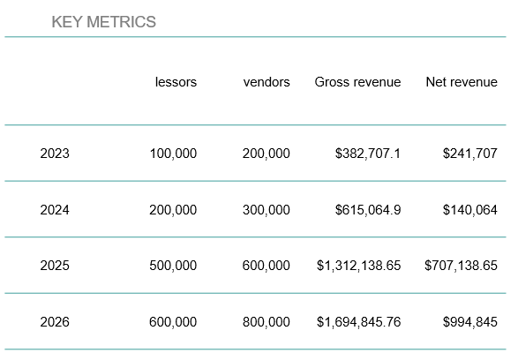
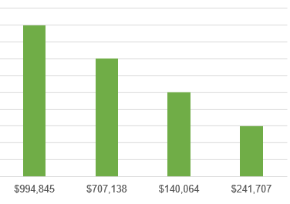
Business Model
2026
2025
2024
2023

Slide 10

Growth strategy
how we'll scale in the future
Year 2
after a steady start , we'll start planing to expand internationally along side updating and improving our app
Year 1
Roll out to local audiences in the region to help establish the product
Year 3
exploring expanding opportunities internationally to a bigger market , and expanding by the end if the year

Slide 11


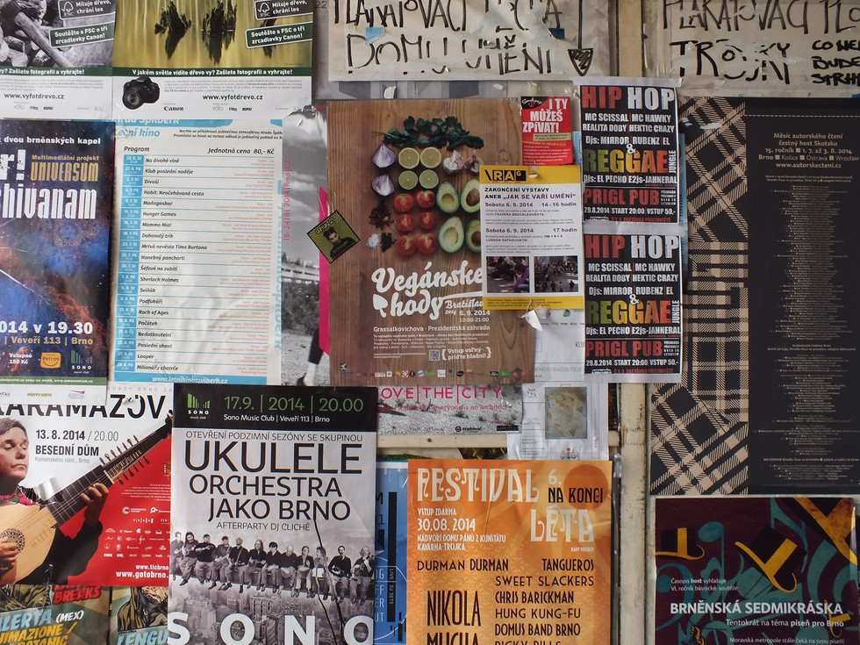
DIGITAL ADVERTISING:
advertising channels such as Google Ads, social media advertising. advertising to target and reach our desired audience.
Go To market!
As a Peer-to-Peer application, our goal is to expand our reach to a wider target audience through versatile techniques that cater to their specific needs.
PUBLIC RELATIONS
relationships with relevant media outlets, bloggers, and journalists to generate positive press coverage about the app.
IN FIELD ADVERTISEMENT
throug billbords and flyers atract and get the target ate

Slide 12
Our unique selling point
Say goodbye to the hassle of multiple apps and hello to the convenience of finding everything you need in one place.
Experience seamless interactions, secure transactions, and a thriving community all within our app.
It's time to simplify your renting, selling, and donating journey with us.
"Rent, Sell, Donate,Earn: All in One Place!"

